Slide 1


RiverSafe Presentation
“Eze 101”
The one stop security tool
Anthony McKale Principal Engineer
15/08/2021

Slide 2
Eze 101
Today we’ll cover
Modern Security Problems
Modern Security Solutions
Why Eze
Advanced Usage (very briefly)

Slide 3
Modern Security Problems

Slide 4
Modern Security Problems
- 1) Dependencies
- 2) User Code
- 3) Infrastructure (outside of scope)

Slide 5
Modern Security Problems
- 1) Dependencies
- 2) User Code

Slide 6

Dependencies
Modern software is built on top of external libraries
Each external library is built on top of others, like the layers of a onion
External libraries tend to be opensource, community created, and the eco systems and licensing are mature
Perfect, right?
What could go wrong ?

Slide 7
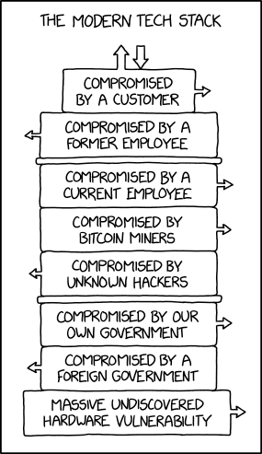
Dependencies
* Stack https://xkcd.com/2166/

Slide 8
Dependency Issue Overview
Common library issues*
Lack of software inventory
Dependency Licensing
Dependency flaws
Dependency supply chain attacks
* Non exhaustive list

Slide 9
Dependency Issue Overview
Common library issues*
Lack of software inventory
Dependency Licensing
Dependency flaws
Dependency supply chain attacks
* Non exhaustive list

Slide 10
Dependencies Inventory / Audit
Lack of inventory of libraries contained in software project
This is known as a SBOM (“Software Bill of Materials”*)
Standard Language tooling doesn’t generate an SBOM, this task often isn’t done, leaving the software owner not knowing the contents of their code
External tools/step are required to generate these
As such,
* https://en.wikipedia.org/wiki/Software_bill_of_materials

Slide 11
Dependency Issue Overview
Common library issues*
Lack of software inventory
Dependency Licensing
Dependency flaws
Dependency supply chain attacks
* Non exhaustive list

Slide 12
Dependencies License poisoning
Licenses of software libraries are not all the same or equal
One particular license risk for commercial software is GPL poisoning
GPL is strong copy left*, this type of license recursively propagates up, aka all software including GPL libraries are automatically GPL licensed
Legally the source code would need to be exposed publicly, and any software patents involved might be at risk, and anyone could sell/copy your code
* Different from weak copy left which is not typically a concern (LGPL)

Slide 13
Dependencies Licensing conditions
Licenses of software libraries even if they are not GPL or other type of strong copy left license often have licensing conditions
These could be :
- Restrictions usage by industry type
Public attribution on adverting
Attribution inside code
Failure to complete this conditions could result in fines, or action by public free software law organisations

Slide 14
Dependency Issue Overview
Common library issues*
Lack of software inventory
Dependency Licensing
Dependency flaws
Dependency supply chain attacks
* Non exhaustive list

Slide 15
Dependencies Software Flaws
Public libraries security faults are public disclosure via the CVE* system
CVE good and bad:
All organisations and engineers can report flaws for the public good
Engineers can easily find and update/or remove insecure libraries
Hackers can easily find flaws in unpatched systems
* https://en.wikipedia.org/wiki/Common_Vulnerabilities_and_Exposures

Slide 16
Dependencies Software Flaws Gotcha
Language compilation tooling doesn’t* perform a security audit of components
External tooling is required to run these security audits
* Node / NPM is a excellent exception of one that does

Slide 17

Dependencies Software Flaws Example Log4J
Widely used library for commercial java software
Zero day* Critical flaw* was found in October 2021 that allowed arbitrary execution
All unpatched software can be remotely hacked
https://en.wikipedia.org/wiki/Zero-day_(computing)
https://nvd.nist.gov/vuln/detail/CVE-2021-44832

Slide 18
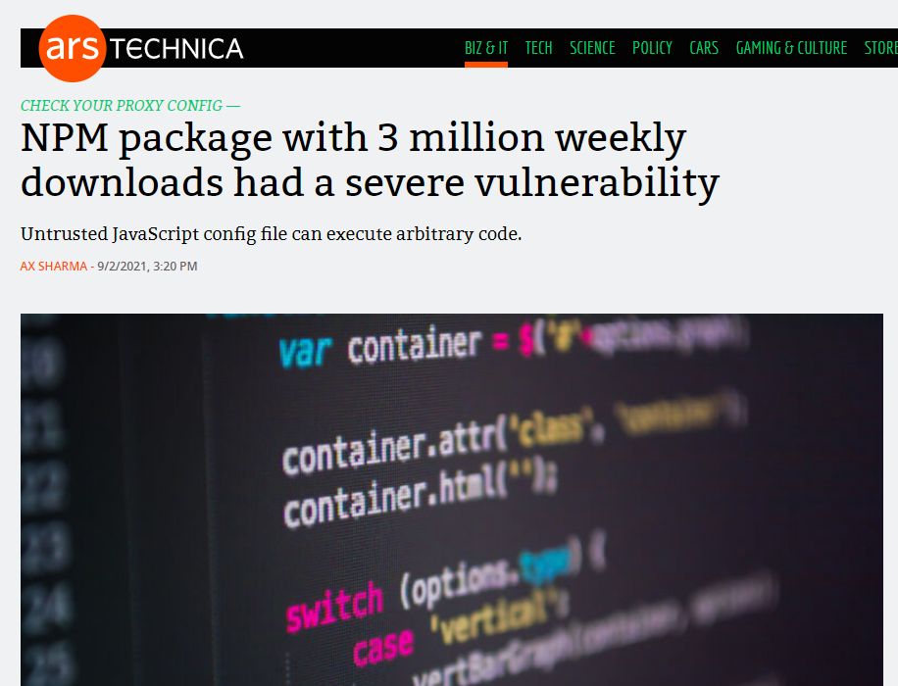
Dependencies Software Flaws Example Node
Widely used library for commercial node software for handling corporate internet proxies

Slide 19
Dependency Issue Overview
Common library issues*
Lack of software inventory
Dependency Licensing
Dependency flaws
Dependency supply chain attacks
* Non exhaustive list

Slide 20
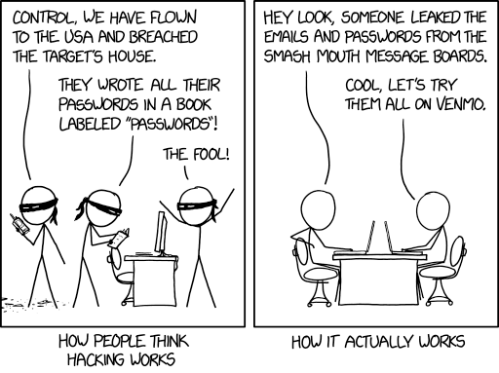
Dependencies Supply chain attacks
* How hacking works https://xkcd.com/2176/

Slide 21
Dependencies Supply chain attacks
Many Opensource libraries are created by small teams of volunteers
These volunteers can be targeted by attackers gaining access to their software projects, and in turn gaining access to all down stream projects including that software
Common attacks
Social Engineering
Hacking personal accounts
Bribery
Vandalism* where the creators intentionally corrupt their own work

Slide 22
Dependencies Supply chain attacks Consequences
hijacked dependency consequences are severe
Library scripts will be run at build time in CI servers, compromising any secrets that CI has exposed
Libraries will be compiled into the resulting applications, so users will be compromised as well
And of course, follow on attacks are possible using stolen credentials

Slide 23
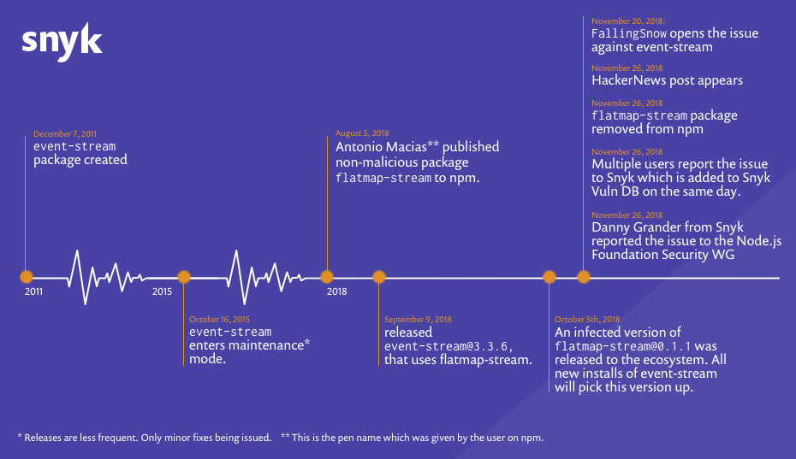
Dependencies Software Flaws Example Node
Widely used library for all node software for handling networking “Event Stream” Hijacked via social engineering, was updated to steal crypto currency
Millions of projects ran corrupted code
https://snyk.io/blog/a-post-mortem-of-the-malicious-event-stream-backdoor/

Slide 24
Dependencies Recent Supply chain attacks
Recent Software Supply Chain Attacks
Excellent more detailed timeline of recent issues from sonatype
https://www.sonatype.com/resources/vulnerability-timeline
Date | Product | Issue
January 2021 | SolarWinds | SolarWinds hijacked, and all 18k customer had their systems compromised
April 2021 | CodeCov | Devops tool hijacked, and 100s of customer credentials in github and beyond stolen
January 2022 | colors/faker node | Disgruntled developer modified his own projects to corrupt 1000s of down stream applications

Slide 25
Modern Security Problems
- 1) Dependencies
- 2) User Code

Slide 26
User Code
Developer application be insecure
Common Anti patterns*
Passwords hardcoded in code
Lack of normalisation of inputs
Insecure special character handling
Insecure library configuration
- * weaknesses are described by CWE (Common Weakness Enumeration) https://cwe.mitre.org/top25/archive/2021/2021_cwe_top25.html

Slide 27
User Code Hardcoded Passwords
Passwords hardcoded in code are unfortunately very common, especially in unscanned code
Common hardcoded password usage
Credentials often hardcoded for systems testing
Hidden in library/package manager configuration files
Deliberately used insecurely
Hardcoded passwords are very risky, code repos are not as secure as password vaults, embedded passwords in frontend code can be exposed via compiled assets
- CWE-798 https://cwe.mitre.org/data/definitions/798.html

Slide 28

Modern Security Solutions Lack of normalisation of inputs
* Exploits of a Mom https://xkcd.com/327/

Slide 29
User Code Insecure special character/element handling
Software is hard, and hackers are clever, special character handling is common source of threats
Text, SQL, JQL, CLI, file paths all have special characters and elements which can do special operations
Developers need to handle these with care, or user input to do a lot more than just set a field
They could delete tables, read private data and more
- CWE-89 https://cwe.mitre.org/data/definitions/89.html

Slide 30
User Code Insecure library configuration
Software Libraries often have configuration options, and not all options are suitable for product code
Examples
networking libraries have options for disabling HTTPS security, these should never be enable for production code
Database SQL libraries have options to take raw SQL which is vulnerable to special character issues
Malconfigured Libraries can bypass authentication, authorisation, and verification, leading to systems being hacked

Slide 31
Questions
Software is hard, a lot of dependencies are insecure, and a lot of code is insecure
Questions ? And solution ….

Slide 32
Modern Security Solutions

Slide 33
Modern Security Solutions Problem List
Common Dependency issues
Lack of software inventory
Dependency Licensing
Dependency flaws
Dependency supply chain attacks

Slide 34
Modern Security Solutions Lack of software inventory
Software inventories can be generated in two major formats
CycloneDX newer owasp defacto standard
Spdx older by well supported format
Proprietary and opensource tools such as synk(P), cyclonedx toolkit (OS) or anchore syft (OS) can generate these from source
* Unfortunately it is normal to install multi tools, as SBOM software is often tailored to a single language

Slide 35
Modern Security Solutions SBOM gotchas
SBOM software is often tailored to a single language, so multiple tools with multiple output formats are required
Not all tools supply license information with their SBOMs

Slide 36
Modern Security Solutions Dependency Licensing
SBOMs contain license of the dependency
License Review options:
manually review all library licenses
Use proprietary vendors* offering license check service in their enterprise tooling
* Eze features a inbuilt opensource license scanner, outside of eze most solutions are cloud based and proprietary

Slide 37
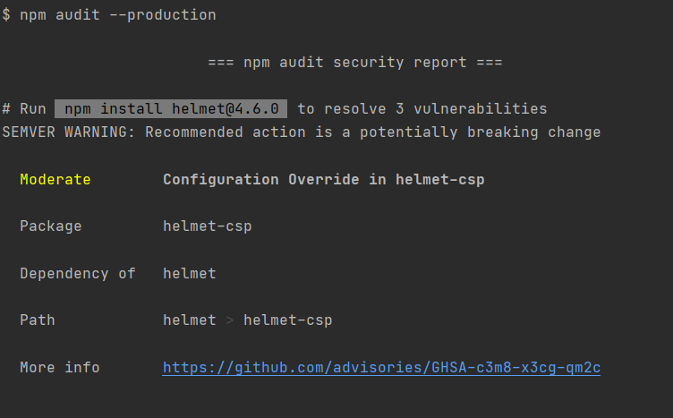
Modern Security Solutions Dependency vulnerabilities / supply chain attacks
Use SCA (Software Component Analysis) tools to catch Vulnerabilities and supply chain attacks
Vulnerabilities can appear at any time
Attacks can target any dependencies

Slide 38
Modern Security Solutions SCA Gotchas
SCA software is typically language specific so multiple tools are required
SCA software is only as good as the known CVEs, zero day exploits are always a threat
Vulnerabilities are found daily, you MUST scan regularly
AVOID small or poorly maintained packages to minimise supply chain risks

Slide 39
Modern Security Solutions Problem / Solution List
Problem | Solution
Lack of software inventory | SBOM software
Dependency Licensing | License check software
Dependency flaws Dependency supply chain attacks | SCA software

Slide 40
Modern Security Solutions Problem List
Common Code Issues
Passwords hardcoded in code
Lack of normalisation of inputs
Insecure special character handling
Insecure library configuration

Slide 41
Modern Security Solutions Passwords hardcoded in code
Passwords in code are now easy to find, as passwords have distinct patterns and structure
Some popular code repos such as github offer this scanning automatically
Password SAST* Tools such as gitleaks or trufflehog can be used in build processes to catch credentials being committed
* Static application security testing tools

Slide 42
Modern Security Solutions Normalisation of inputs / Insecure special character handling
Library functions for safety handling inputs exist for most languages
SAST* tools exist for most languages to automatically detect when these normalisation functions aren’t being called
These flag obvious issues, such as:
Building SQL payloads without parameter normalisation
Running CLI commands without parameter normalisation
Code smells where something is probably not correct in the code == vs === in javascript
Warning though, code is complex, and these tools aren’t perfect
* Static application security testing tools

Slide 43
Modern Security Solutions Insecure library configuration
Libraries can be configured in many ways, and SAST* tooling can detected obvious anti-patterns
Such as:
Turning off HTTPS security
Enabling insecure signature algorithms most famously the JWT “none” encryption
Using insecure or broken encryption aka SHA-1 or the like
Warning though, same as before, code is complex, and these tools aren’t perfect
* Static application security testing tools

Slide 44
Modern Security Solutions Problem / Solution List
Problem | Solution
Passwords hardcoded in code | Password SAST software
Lack of normalisation of inputs | SAST software
Insecure special character handling | SAST software
Insecure library configuration | SAST software

Slide 45
Modern Security Solutions Problem / Solution List
Problem | Solution
Lack of software inventory | SBOM software
Dependency Licensing | License check software
Dependency flaws Dependency supply chain attacks | SCA software
Passwords hardcoded in code | Password SAST software
Lack of normalisation of inputs Insecure special character handling Insecure library configuration | SAST software

Slide 46
Questions
So to secure your software you just need to install:
SBOM tooling
License checking tooling
SCA tooling
Password SAST tooling
SAST tooling
For every language you use… easy right ?
Questions, then onto why we made eze (see above)

Slide 47
Eze Overview

Slide 48
Eze Raison d'être
Securing software is really hard, requiring multiple tools, each requiring custom configuration and setup
At RiverSafe we’ve helped customers many times implement these tools and integrate them with their reporting
opensource tools
proprietary tools (blackduck, checkmarx etc)
Inbuilt coderepo tools
Each time it was expensive, and time consuming

Slide 49
Eze Raison d'être
Eze was created because we, and the industry are always reinventing the wheel, doing the same tasks again and again
Synk was the best at node
Blackduck was the best at Java
Sonarqube was averagely good across the board
Github advanced security didn’t do license scanning
No one tool did everything perfectly

Slide 50
Eze Raison d'être
Eze is a extensible opensource tool built by RiverSafe that collects the best security tools into a docker image
Ran from a single docker command, locally or in a pipeline, it did all the scanning in a single step

Slide 51
Eze Features

Slide 52
Eze Features
It’s easy to use and customise
Unwanted capabilities can be disabled
New tools can be added
Easily added to pipeline
all tool output is normalised into industry standard JSON (SARIF and cyclonedx)
It’s opensource and free*
* Eze cli is opensource and licensed using MIT license, Eze management console is proprietary commercial offering

Slide 53
Modern Security Solutions Problem / Solution List
Tooling installed every time afresh
Problem | Solution
Lack of software inventory | SBOM software
Dependency Licensing | License check software
Dependency flaws Dependency supply chain attacks | SCA software
Passwords hardcoded in code | Password SAST software
Lack of normalisation of inputs Insecure special character handling Insecure library configuration | SAST software

Slide 54
Eze Tools
Tools | Solution
Ancore Syft (multi) CycloneDX suite (mutli) | SBOM software
Inbuilt into the SBOM handler | License check software
Anchore grype (multi) Dependency check (Java) NPM Audit (Node) Trivy (containers) KICS (container) Safety (python) | SCA software
Trufflehog, Gitleaks | Password SAST software
Bandit (python) Safety (python) Spotbugs (java) Semgrep (many) | SAST software
https://hub.docker.com/r/riversafe/eze-cli

Slide 55
Eze in Action

Slide 56
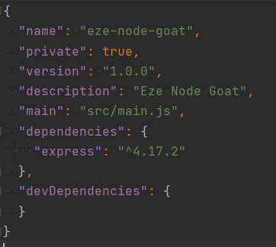
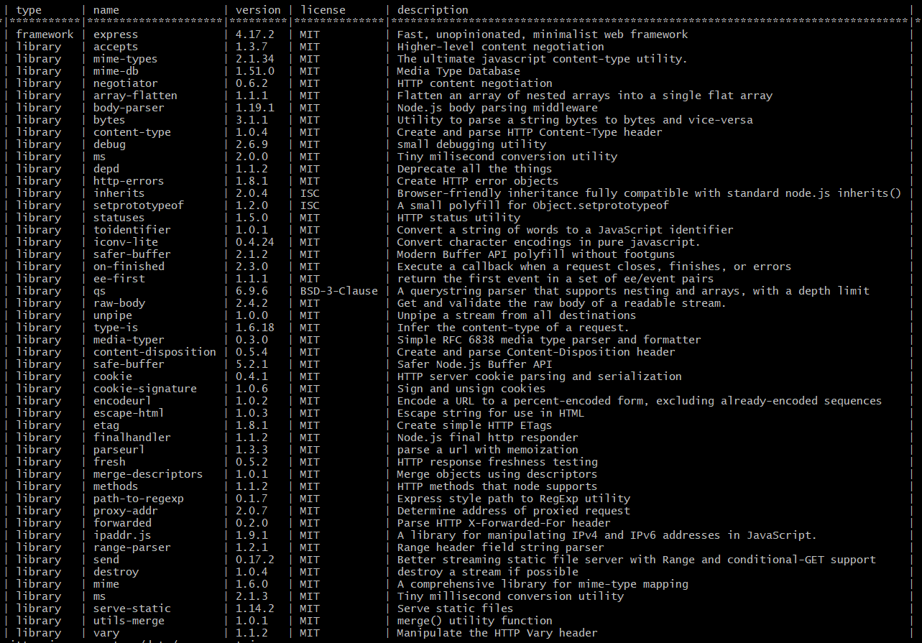
Eze in Action: SBOM
DEMO

Slide 57
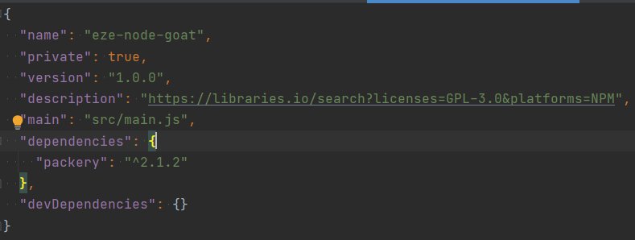
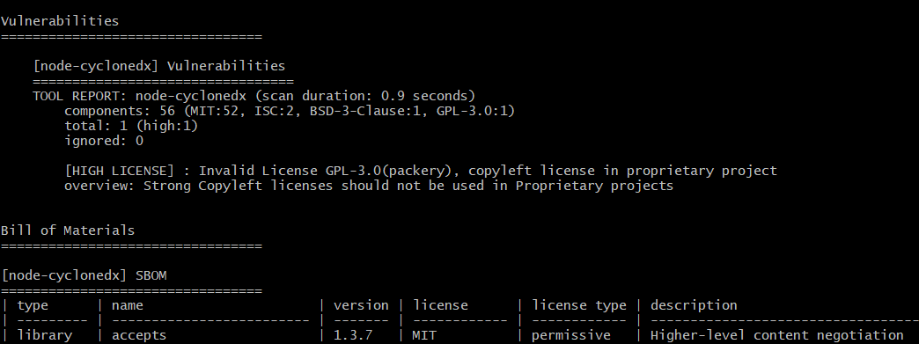
Eze in Action: License
DEMO

Slide 58
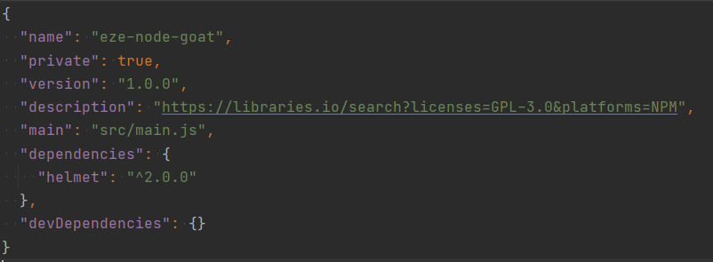
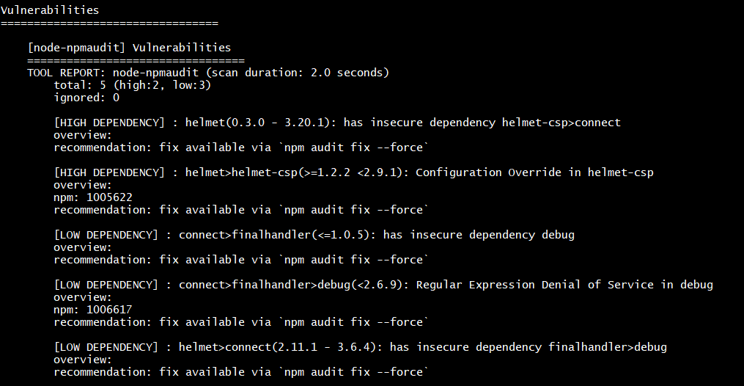
Eze in Action: Vulnerabilities
DEMO

Slide 59
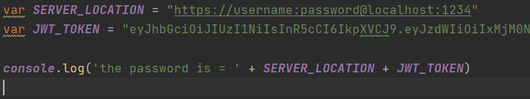
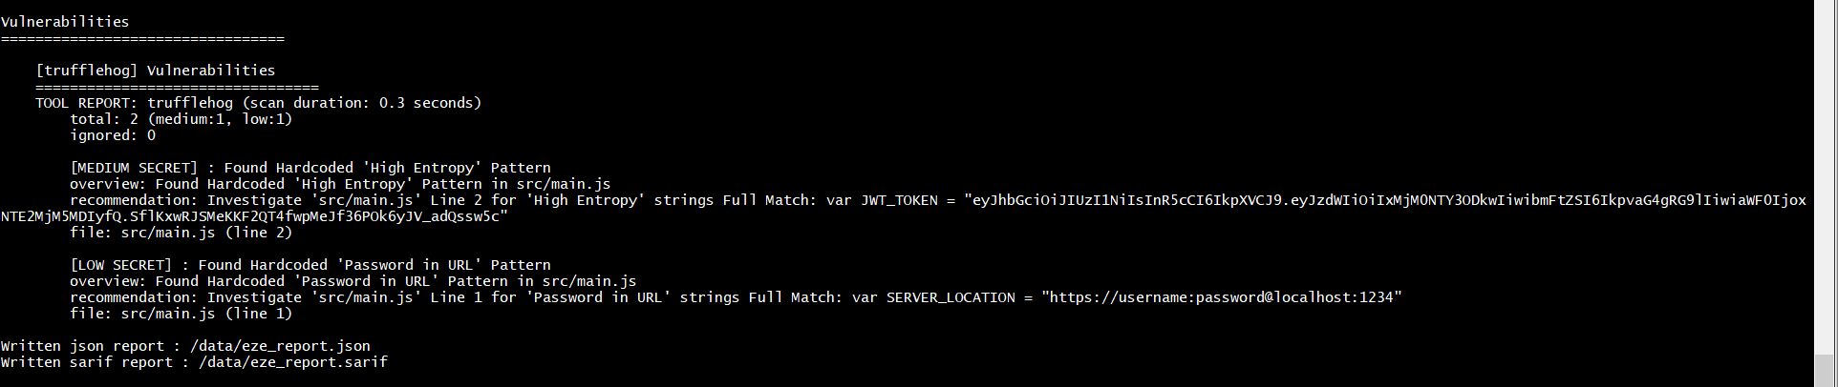
Eze in Action: Hardcoded passwords
DEMO

Slide 60
Questions
Questions ?

Slide 61
Advanced Usage
(In Brief)

Slide 62
Advanced Usage
Running remotely
Parsing the reports from multiple codebases

Slide 63
Advanced Usage Running remotely
Eze can be ran on:
developer machine during development
Build CI server / Github action during development

Slide 64
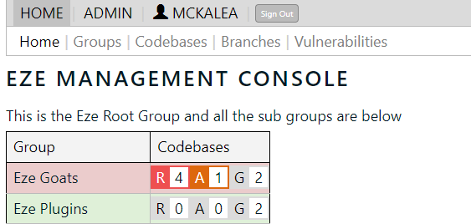
Advanced Usage Eze Management Console
Eze JSON reports can be ingested by data lakes and the like
RiverSafe also has a Management console in development for correlating an organisations applications under one view

Slide 65
Eze Management Console
Eze Management allows for :
long term analysis of vulnerability trends
Tracking active vulnerabilities across a large software estate
Remote scans on git repos
Schedule scans for catching
Remote tool configuration
Contact us after the presentation for details

Slide 66
Questions
Questions ?

Slide 67
Questions
I’ve been Anthony M^{c}Kale Email : anthony.mckale@riversafe.co.uk

Slide 68
Thank
you

